Slide 1
Capabilities Most Financial Managers Don’t Know About Microsoft TEAMS
Benjamin Cella
Jackie Airhart Elfe
Pamela Dvirnak
Kermitt Francis II

Slide 2
Agenda
Chat
  Pin & Delete
  Pop out Chats
  Edit Last Chat
Rearrange TEAMS
Channel Notifications
Meetings
  Join External Meetings
  Bypass Lobby
  Content Pop Out
Open in Desktop App
Co-Authoring
Sheet View
Loop Component
TEAMS Calendar
Apps
  Channel Calendar
  List
  OneNote
  Planner
  Power Apps
  Power BI

Slide 3
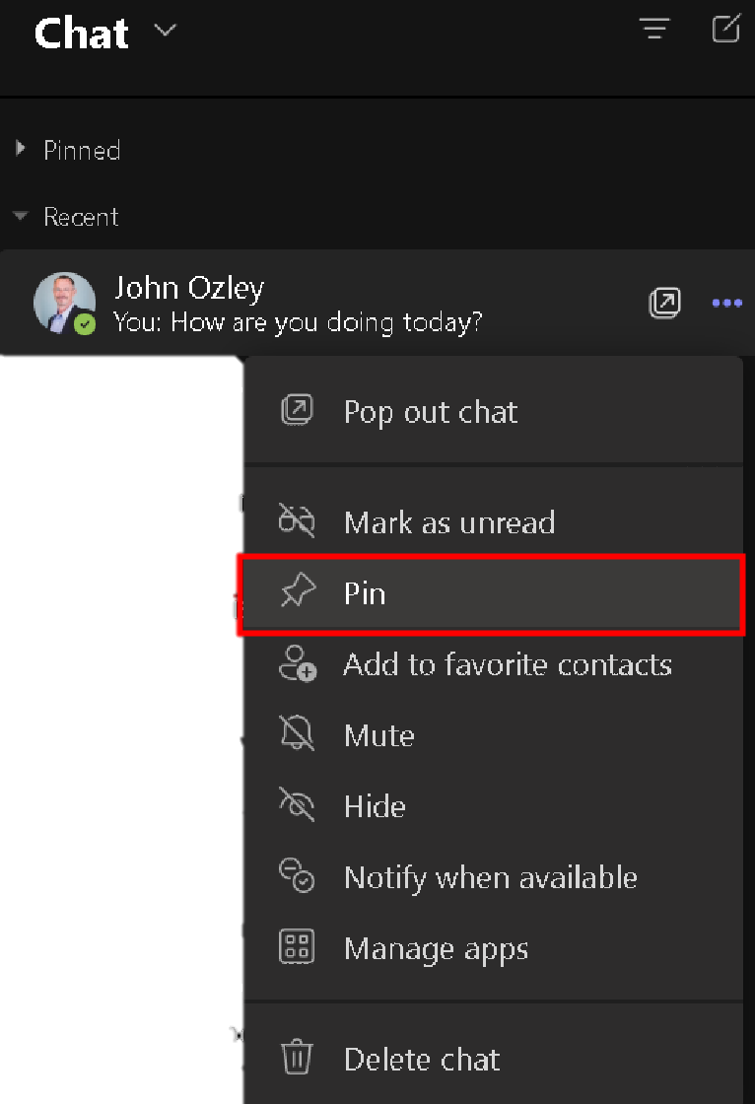
Pin & Delete Chats
Pin people you chat with often
They’ll show up at the top
You can also now Delete chats

Slide 4
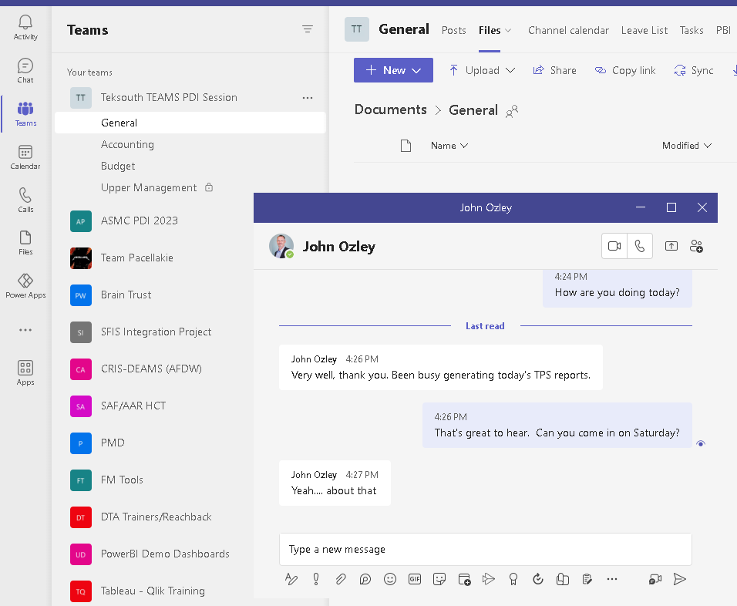

Pop Out Chat
Want to chat with someone and do other things while in TEAMS?
Pop out a chat!

Slide 5
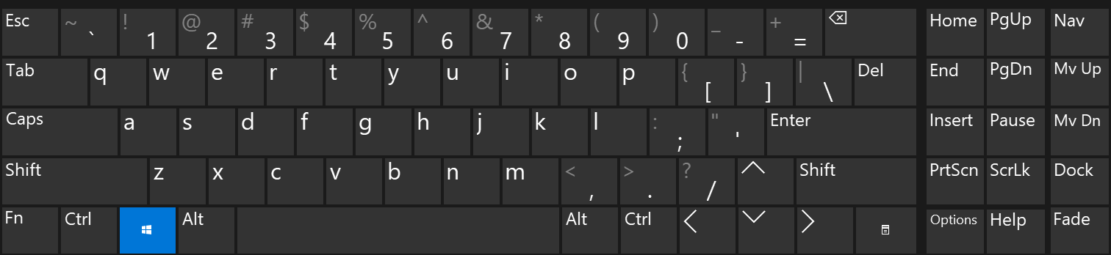
Edit Last Chat
Press the up arrow to quickly edit your last sent message

Slide 6
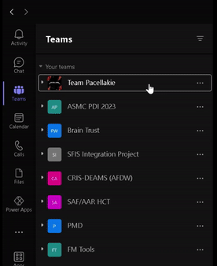
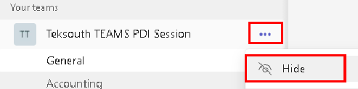
Rearrange TEAMS List
Reorder TEAMS list by clicking and dragging
Hide infrequently used TEAMS

Slide 7
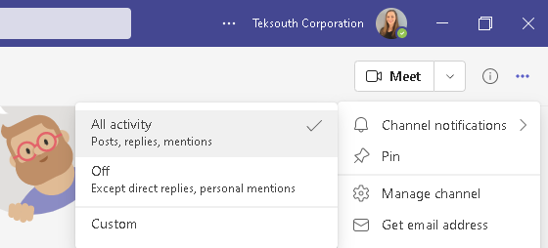
Channel Notifications
Turn on Channel Notifications when you get added to a TEAM
This way you don’t miss anything happening in the TEAM

Slide 8

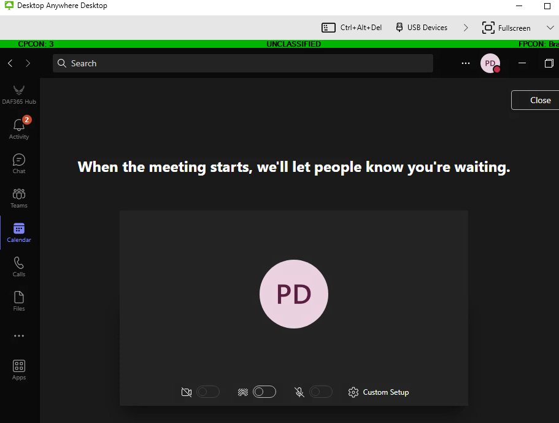

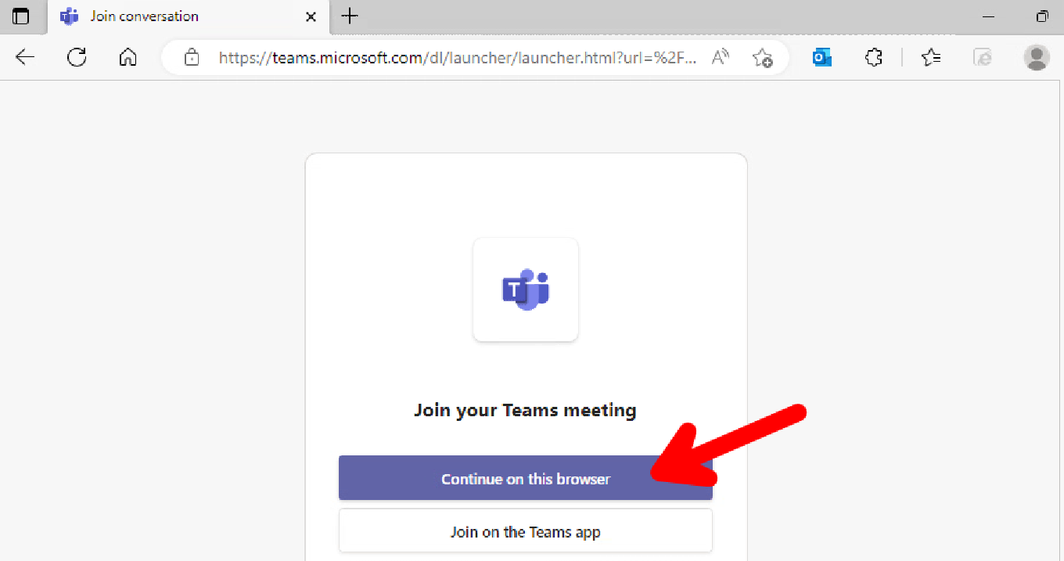
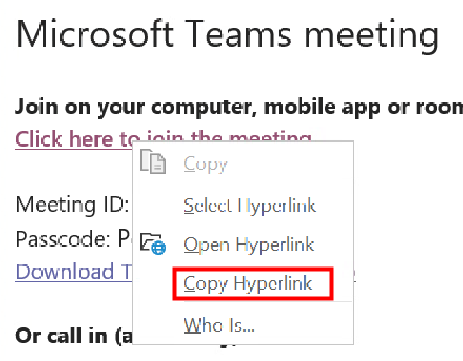
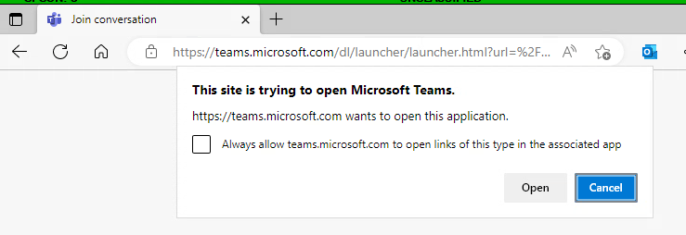
Join Meetings External to DoD
Joining via TEAMS app gets you stuck in the lobby indefinitely
Join via the WEB BROWSER
  Right-Click and copy the hyperlink
  Paste link into the browser
  Click Cancel to the pop-up
  Select ‘Continue on this browser’

Slide 9
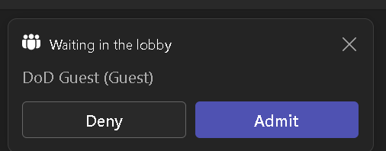
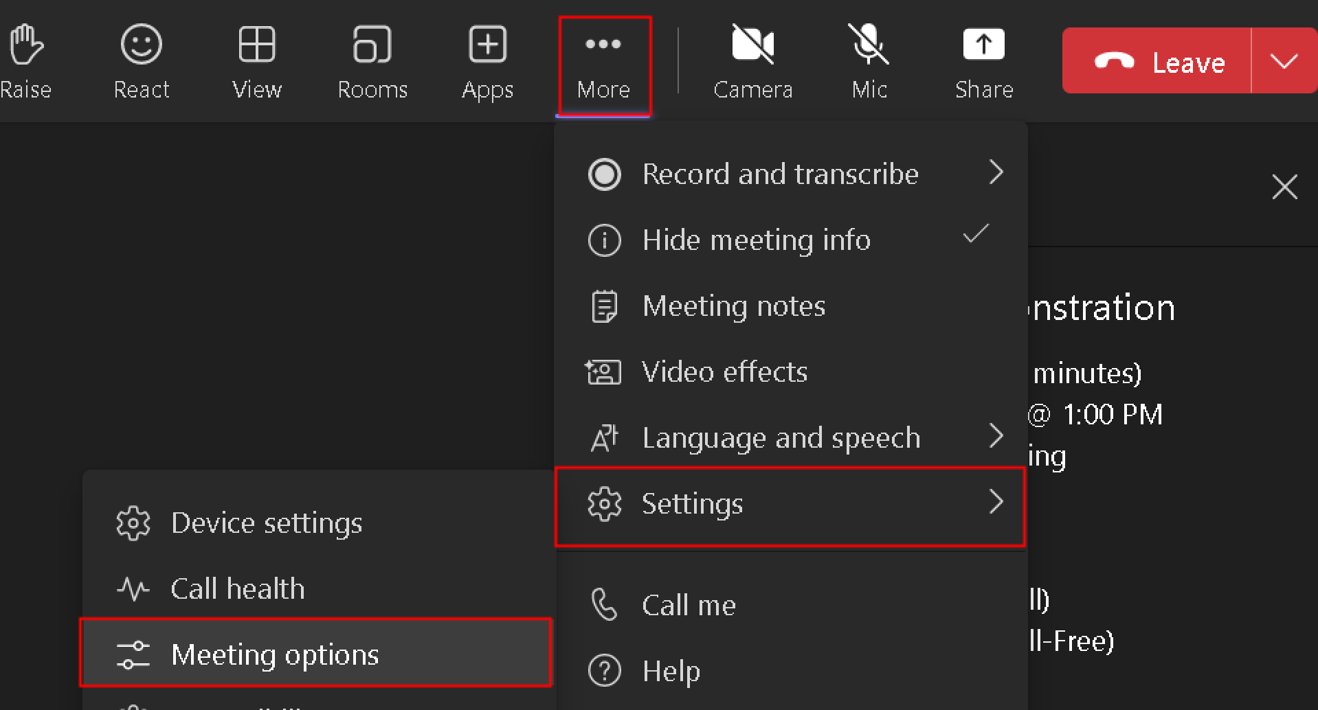
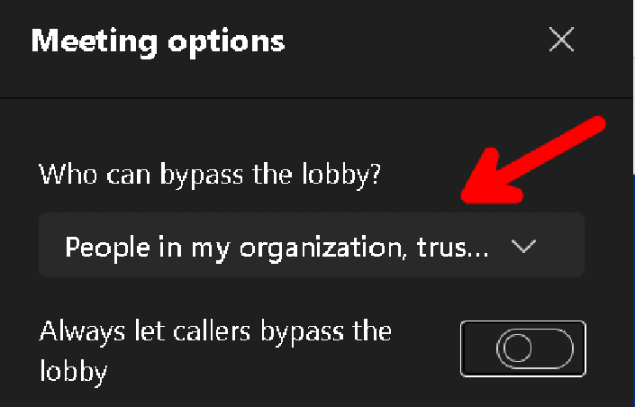
Bypass Lobby
Allow people to bypass the meeting lobby

Slide 10
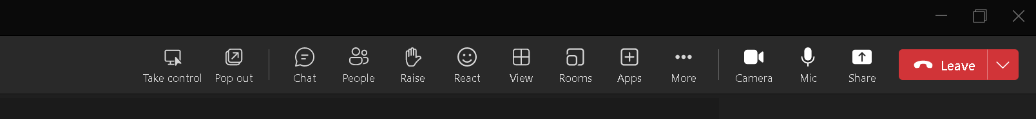
Content Pop Out
Click ‘Pop Out’ to separate content being shared to another window
This will make the content larger and easier to see

Slide 11
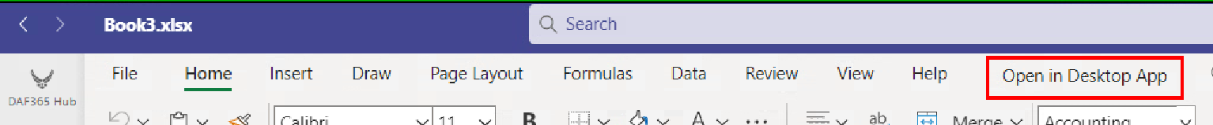
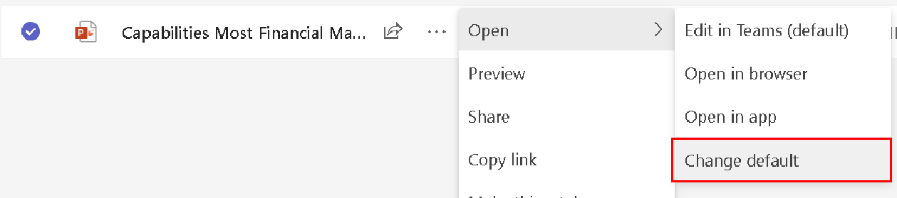
Open in Desktop App
By default, TEAMS uses the Office web browser to open files
Open files in desktop app instead
  Use fully featured application while files still save to same SharePoint location
Can change default behavior
Notes:
For me its under Editing. On the gov computer, the option shows as its own tab

Slide 12
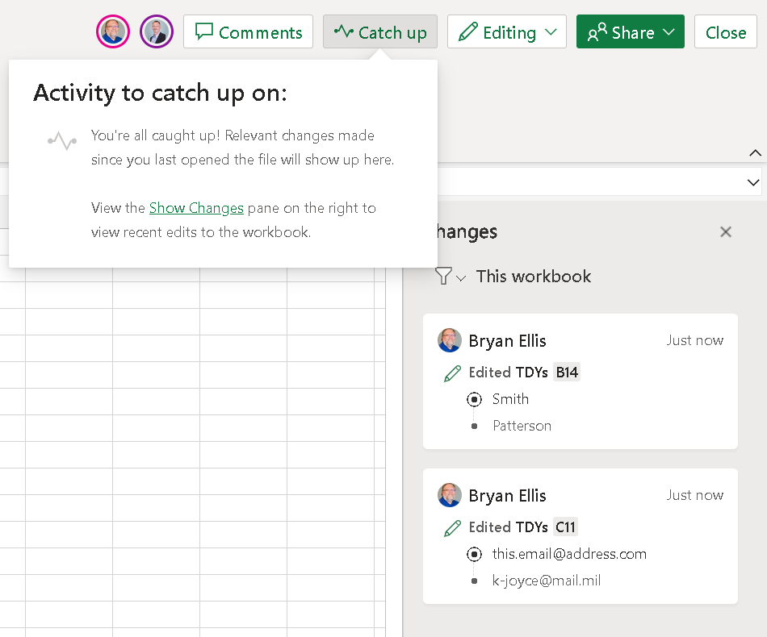
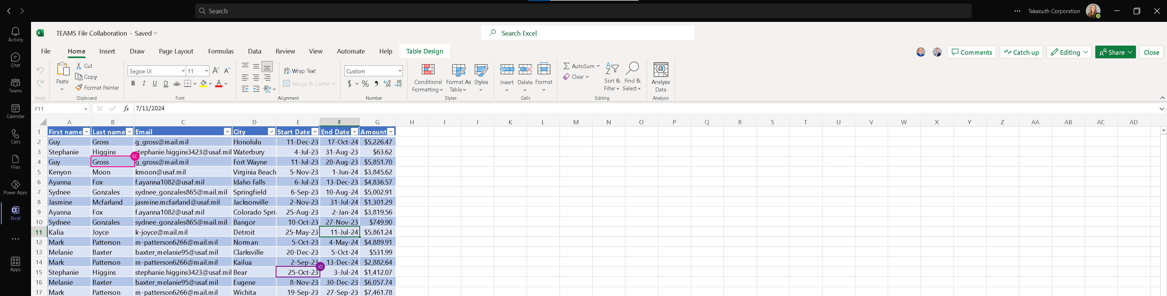
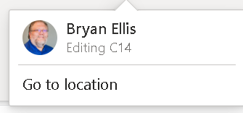
Co-Authoring
Simultaneously work on files
Within Chat or within Channel
Upper-right corner will show other editors
Click on their icon to jump to their location
Colored sections and initials will show where they are

Slide 13
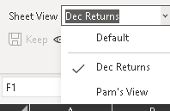
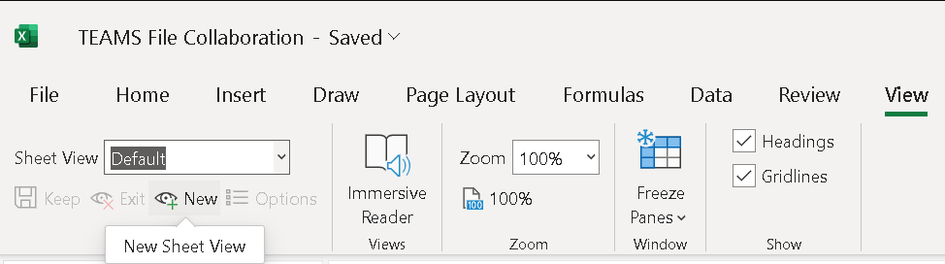
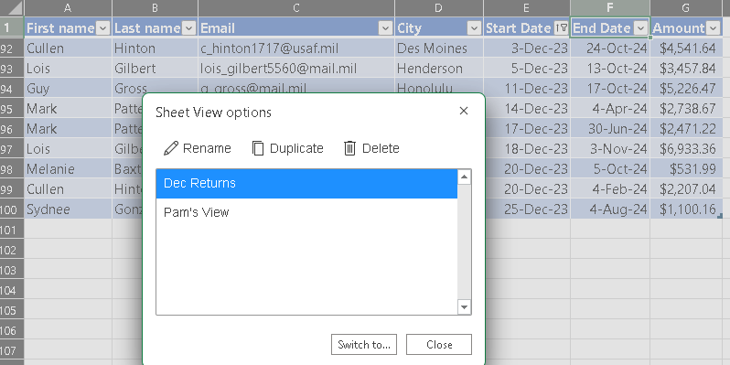
Sheet View
Set up a personal view of a sheet
Won't impact what other people see
Can filter, sort, as you prefer
Views are saved
Name views to personalize them and toggle between multiple views

Slide 14
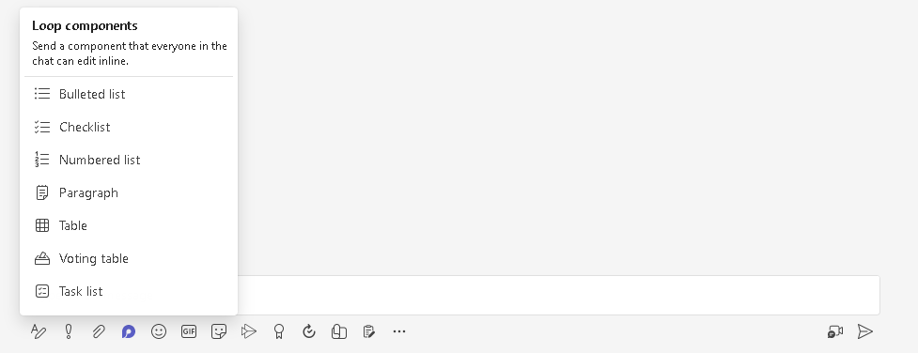
Loop Component
Editable component that everyone in the chat can edit inline and see changes as they're made.

Slide 15
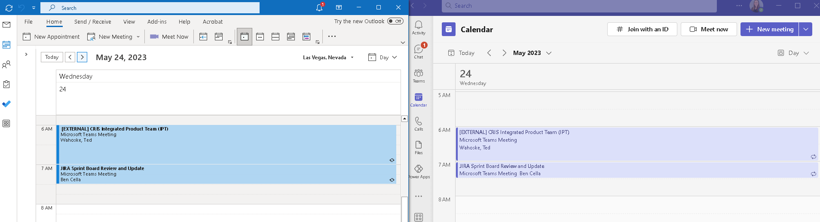
TEAMS Calendar
TEAMS Calendar and Outlook Calendar are integrated
Meetings made in either Outlook or TEAMS will show up on the other calendar

Slide 16
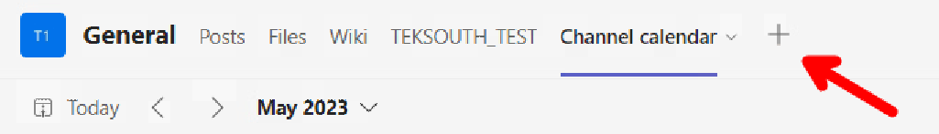
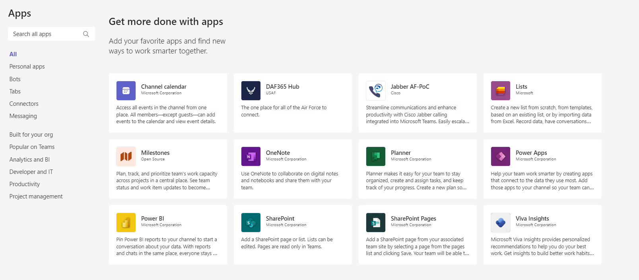
Apps within TEAMS
Click ‘+’ to add a tab
Pick from the app selection

Slide 17
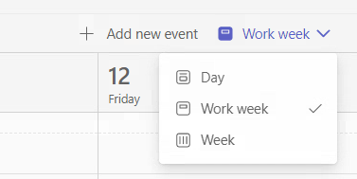
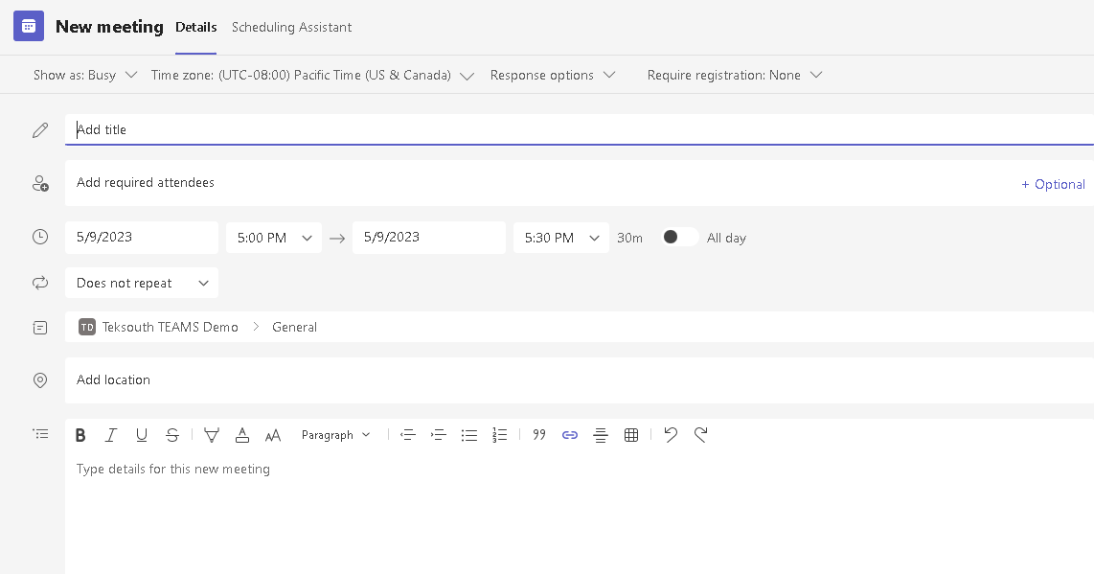
Channel Calendar
Specific to that CHANNEL. Not whole TEAM.
Not available in private channels
Can View by Day, Week or Work Week
Can’t view by Month
Event is added to organizer’s Outlook & TEAMS calendar
Invite NOT sent to channel members unless names added individually
Can’t apply conditional formatting
Can’t add additional fields if you want
Can’t make fields mandatory
Notes:
Leave Calendar
Pros
Integrated with outlook for organizer
Cons
As manager, want to add subordinates leave to calendar without adding to my own.
Can’t view whole month at once
Can’t apply conditional formatting
Not available in private channels

Slide 18

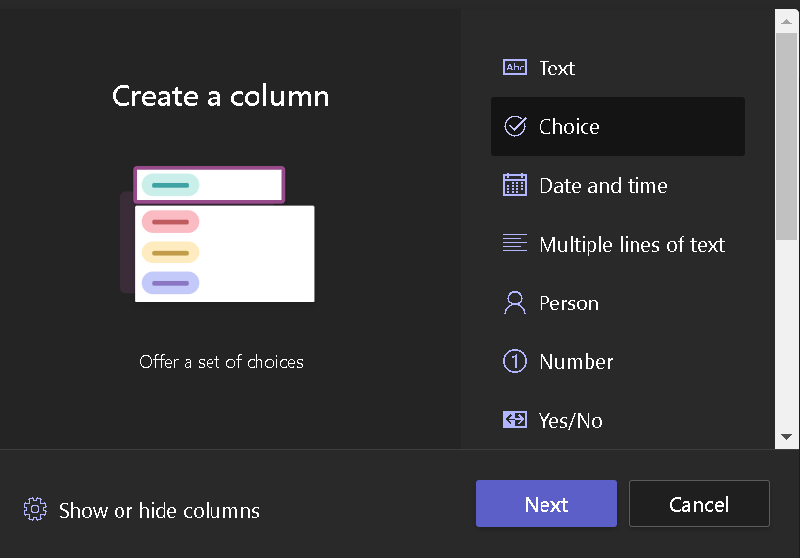
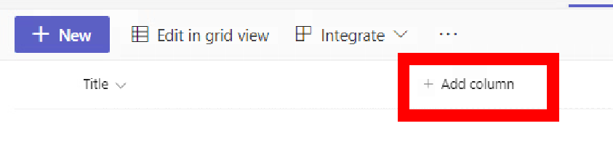
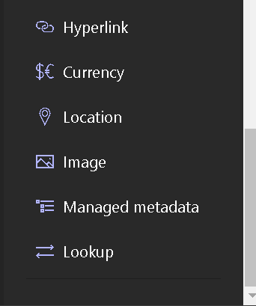
Lists
Create a list from scratch, templates, already existing list or csv file
Control over the fields
Can make fields mandatory
Notes:
Use Cases: Issue Tracker / Leave Calendar

Slide 19
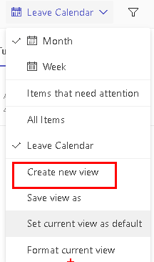
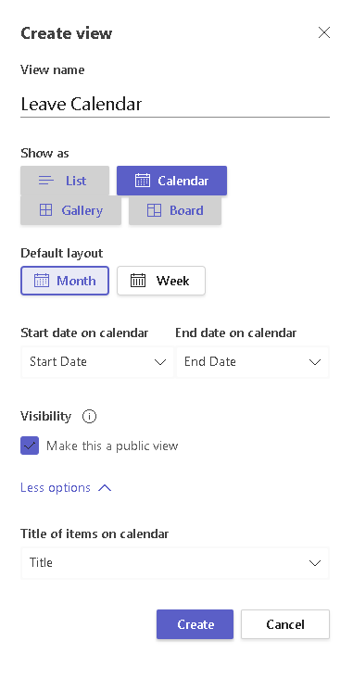
List as Calendar
2
Add Date column(s) to list
Click View Drop down menu
Select ‘Create new view’
Name the view
Select ‘Calendar’ under Show as
Select Default Layout: Month or Week
Pick the Start and End Date fields
Click Create
Set Current View as Default
3
9
4
5
6
7
8
Notes:
Who – links to organization. Can’t sort by last name.
Choice – forces consistency so can apply conditional formatting

Slide 20
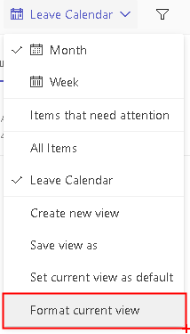
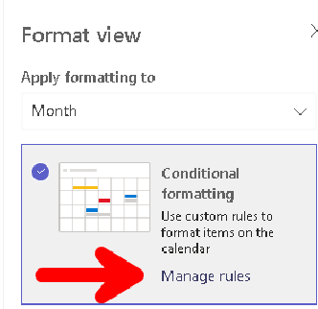
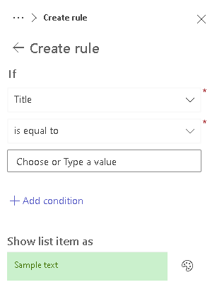
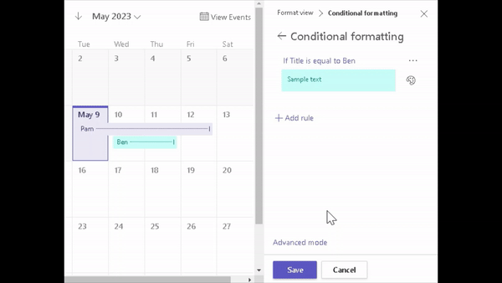
Conditionally Format List
Click ‘View’ Drop down menu
Select ‘Format current view’
Click Manage rules
Create rule and click Save
1
4
2
3
Notes:
Who – links to organization. Can’t sort by last name.
Choice – forces consistency so can apply conditional formatting

Slide 21
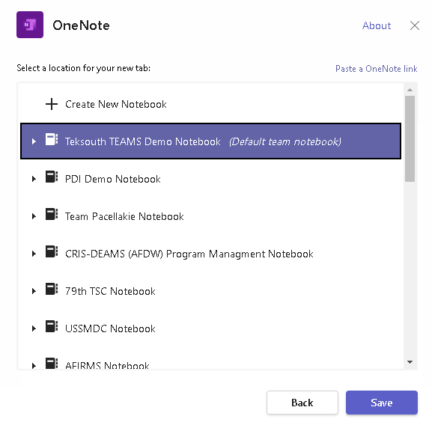
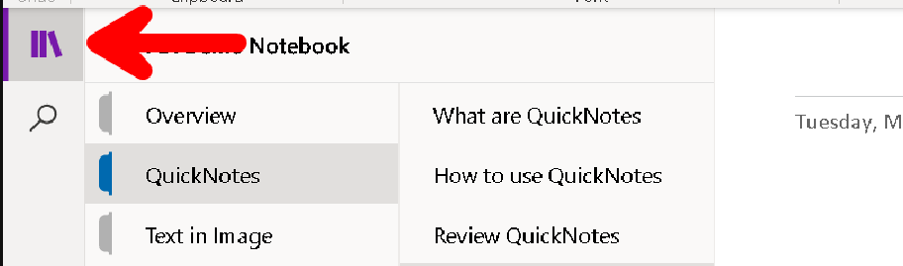
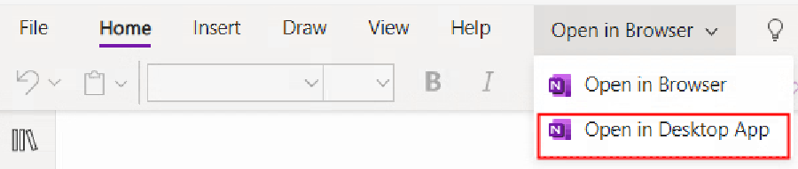
OneNote
Pick the Notebook to add
Click Save
Click ‘Show Navigation’ to see Sections & Pages
Click Open in Desktop App to use
OneNote App instead of TEAMS

Slide 22
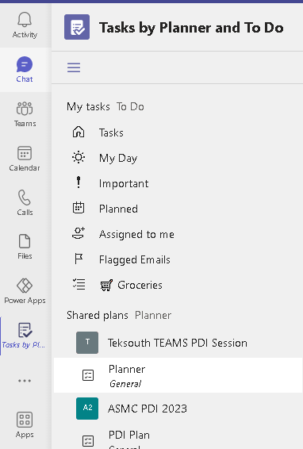
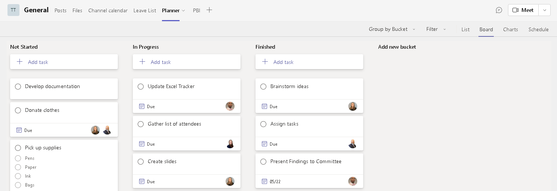
Planner
Add any buckets that make sense
Add Planner to left panel and you’ll see all tasks assigned to you, no matter which plan they are in.

Slide 23
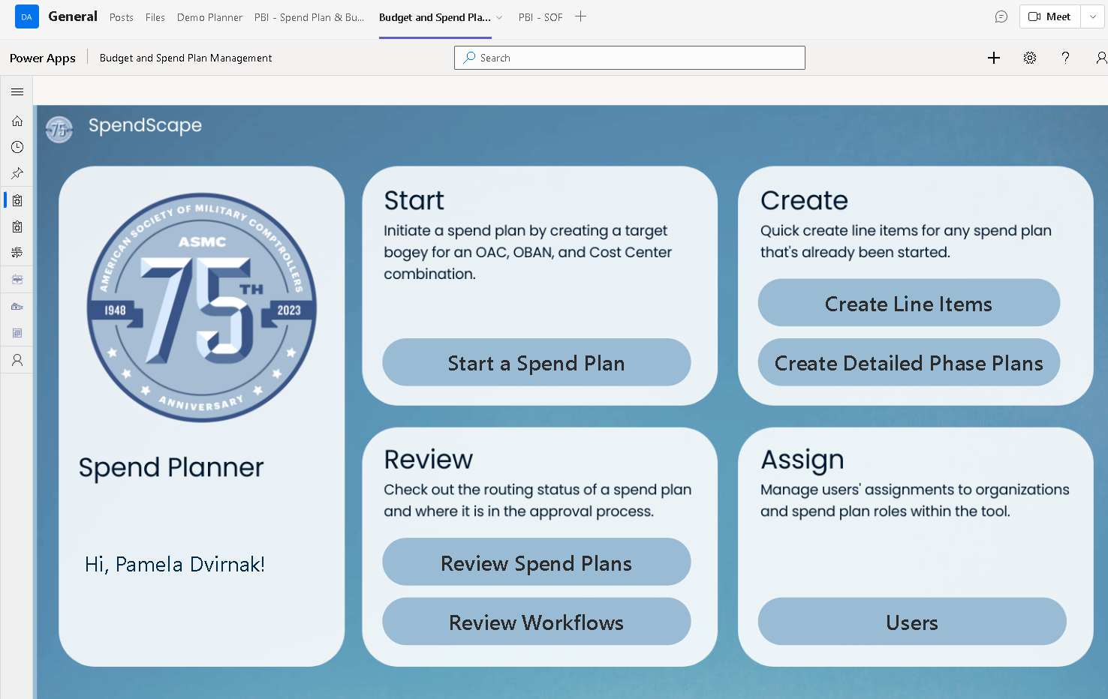
Power Apps

Slide 24
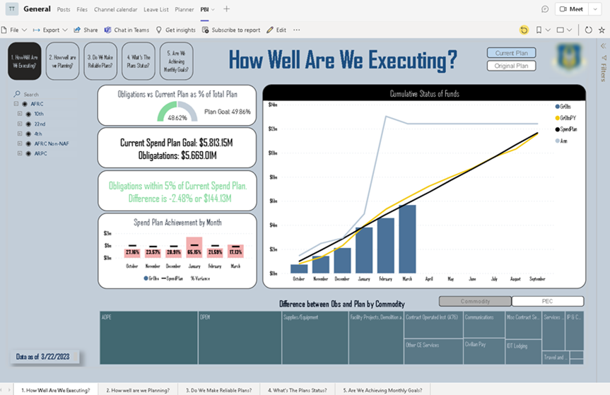
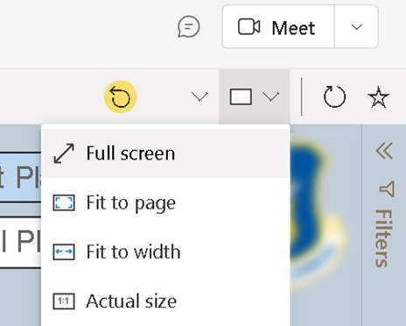
Power BI
Remembers where you navigated to for one hour
Dashboard needs to be published to the Service

Slide 25
Questions?

