Slide 1
PowerPoint Pointers by Pam
How to Razzle Dazzle ‘em

Slide 2
Agenda
Zoom
Morph
SmartArt
Eyedropper
Fragment Shapes
Align & Distribute Evenly
Grid Image
Remove & Replace Background
Convert to shape
Presenter View
Subtitles
Shortcuts
Slide Show in Window
Screen Recording
Embed Power BI

Slide 3
Zoom
Easily create a summary slide with links to other slides
Allows audience to zoom in and jump to specific sections
To use:
Select the slide to be the summary slide
Select Slide Zoom (Insert Tab > Zoom drop-down menu)
Choose the slides to link to
Arrange as desired
Customize the layout and design using the Format tab
Notes:
In desktop version, not online.

Slide 4
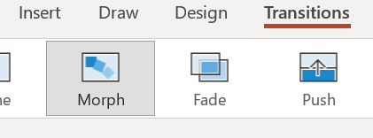
Morph
Smooth animations and transitions between slides and objects
Creates dynamic attention-grabbing presentations
Can emphasize key points
To Use
Create the slides or objects you want to animate and duplicate it
Make any necessary changes to the second version
Click Transitions, then Morph (for the 2nd slide or object)
Create complex animations by duplicating and editing multiple objects and applying the Morph transition between them.
Duration and other settings can be adjusted in the Transitions tab

Slide 5
Morph Example
Make a copy of the slide
Duplicate the picture
Change bottom picture to gray scale
Stack both pictures directly on top of each other
Crop the top picture to what you want to draw attention to (as oval shape)
Duplicate this slide 3 more times
On each slide, adjust the cropped oval to who you want to draw attention to
Duplicate the very first slide and move to the end
Select the 2nd through 6th slides, click morph

Slide 6
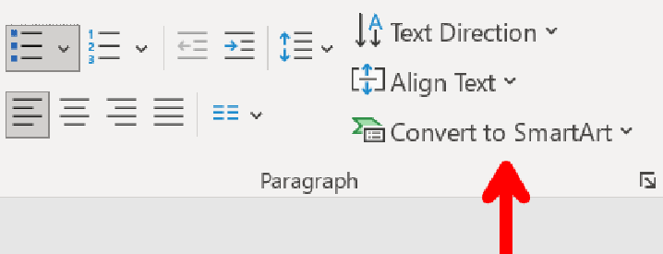
SmartArt – Org Chart
Create professional-looking diagrams and graphics
Useful for presenting complex info in organized and visually appealing way
Create from scratch or convert existing text or bullet points
Includes hierarchies, relationships, matrices, and pyramids
To Use
Select the text to convert
On the Home tab, select ‘Convert to SmartArt’
Choose the graphic to create
The layout and design can be customized using the SmartArt Tools tab
Add or delete shapes, change colors and styles, and rearrange elements as needed

Slide 7
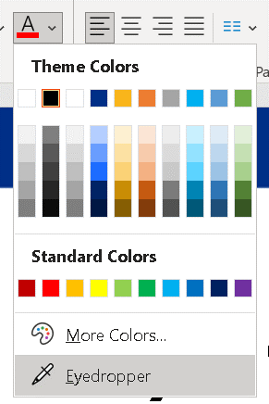
Eyedropper
Can match colors of objects in the presentation
Useful for creating a cohesive and professional-looking design
To Use
Select what you want to apply the color to
Use < CTL > to select multiple things
Select the eyedropper
Home Tab > Font Color drop down menu
Select the color you want to match

Slide 8
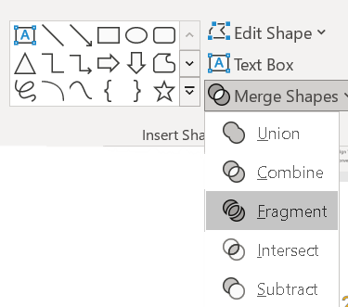
Fragment Shapes
Can create custom shapes
Useful for creating unique and complex shapes
PPT fragments or cuts along the edges where the shapes meet
To Use
Stack shapes on top of each other
Select all shapes
Shape Format > Merge Shapes > Fragment
Notes:
To draw a perfect shape, hold down shift.

Slide 9
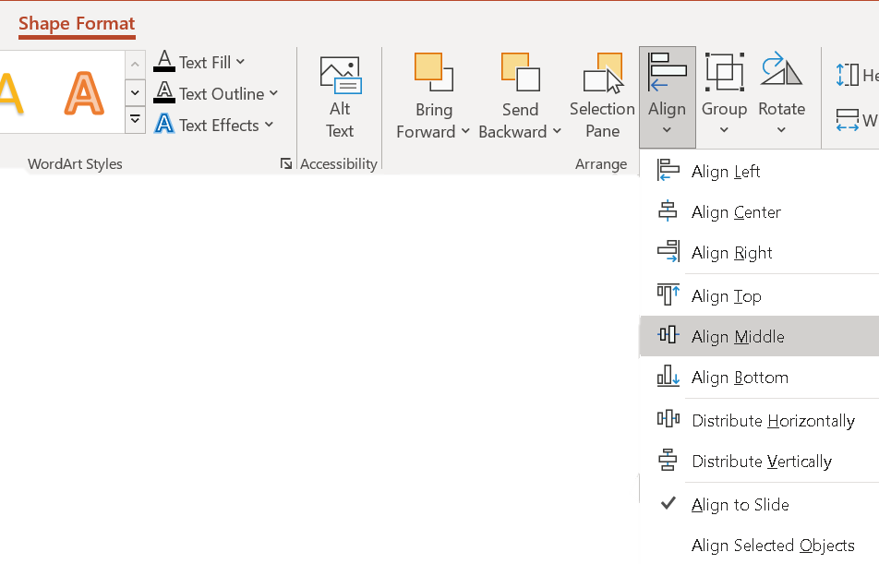
Align / Distribute evenly
Quickly arrange multiple shapes with precision and consistency
Can arrange shapes, text boxes, images, and other objects
Useful when creating diagrams and flowcharts
Arranged Horizontally or Vertically
Aligned to each other or to the slide
Notes:
It can be difficult to manually align and space shapes evenly

Slide 10
Grid Image
Create fun, visually appealing designs
To Use
Insert Square
Duplicate and line it up in a 3x3 grid
Group the squares
Shape Fill > Picture

Slide 11
Remove & Replace Background
Powerful photoshop like tool
Help create visually appealing and professional-looking presentations with ease
To Remove Background
Select the image and go to the Format tab
Click ‘Remove Background’ under the Adjust group
PowerPoint will automatically try to identify the background and mark it with a purple overlay
Refine the selection by using the Mark Areas to Keep and Mark Areas to Remove tools.
Click on Keep Changes
To Replace Background
Select the image and go to the Format tab
Click on ‘Change Background’ under the Adjust group
Choose the type of background you want to use, such as a solid color, a gradient, a texture, or an image.
Adjust the settings as necessary, such as the transparency, the color, or the brightness.
Click Apply

Slide 12
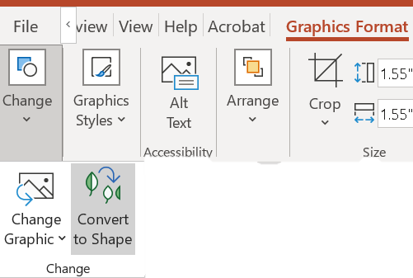
Convert to Shape
Convert icons, logos, or other vector graphics into editable shapes that can be customized and manipulated
Easily manipulate shapes and colors of an icon or logo to match presentation's theme or branding
Shapes can be ungrouped to edit individual components, such as the lines and curves that make up the icon.
Avoids issues with resolution and scaling that can occur when using raster graphics
To Use
Insert an icon and select it
Select the ‘Graphics Format' tab
Click 'Convert to Shape’ in the ‘Change' group
Notes:
Graphic versus Picture
A graphic in PowerPoint is any image that is not a picture. A graphic most typically refers to a grouping of shapes into an image, commonly referred to as vectors.
Vector graphics can come in many file type. The ones accepted by 365:
SVG
EMF
Icons inside PPT are Vectors.

Slide 13
Presenter View

Slide 14
Presenter View
Shows current slide, next slide, and speaker notes

Slide 15
Presenter View
Use font buttons to increase notes size

Slide 16
Presenter View
Magnifying glass icon allows you to zoom in on a part of the slide

Slide 17
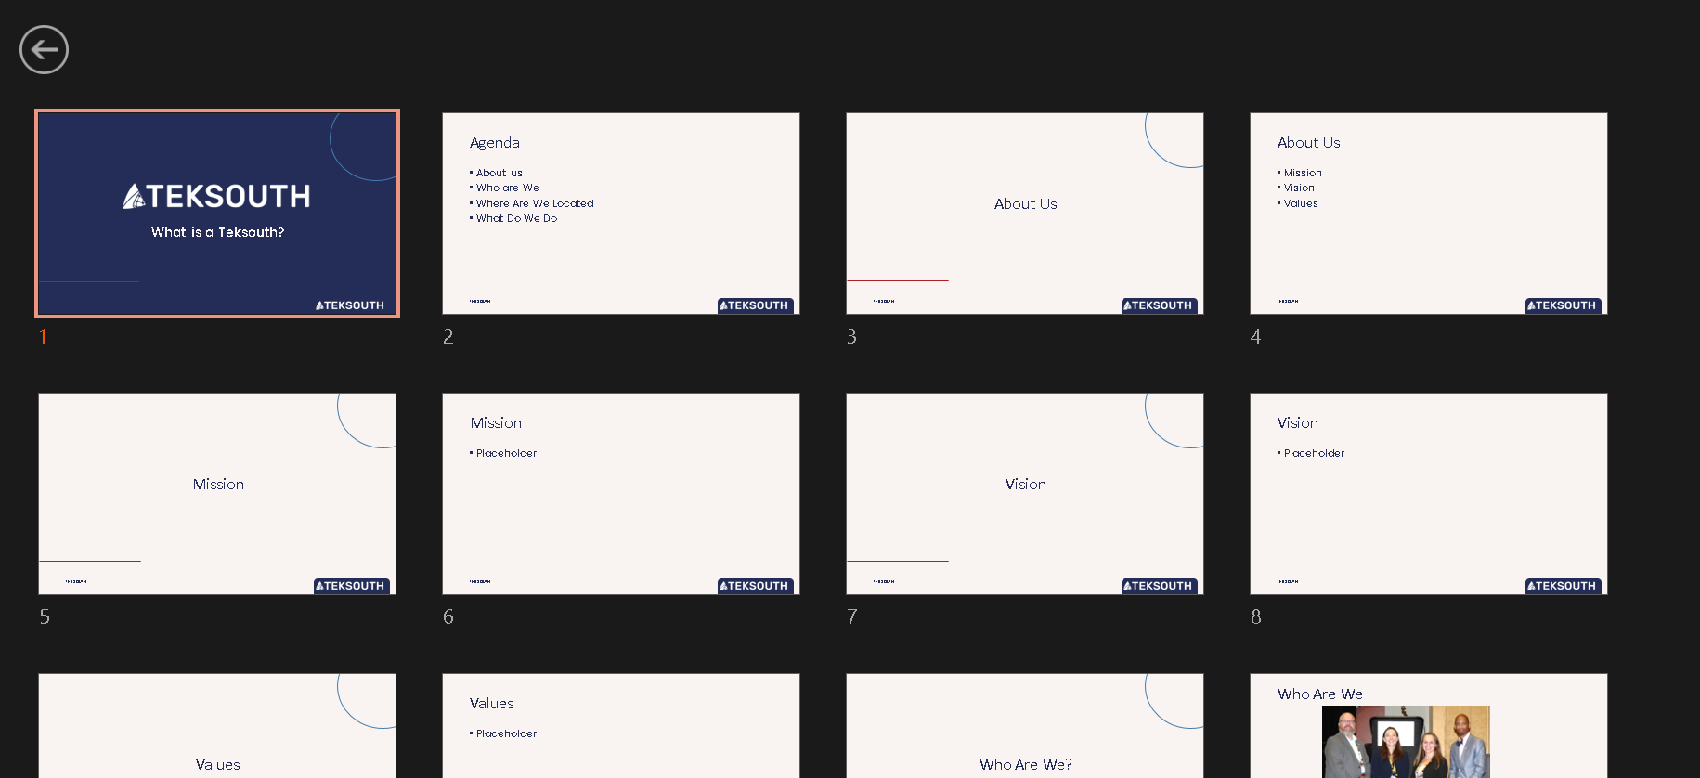
Presenter View
Select thumbnail icon to see all slides and quickly jump to another slide.

Slide 18
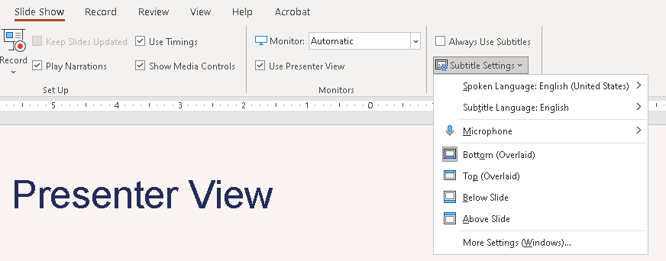
Presenter View
Subtitles – make presentations more accessible

Slide 19
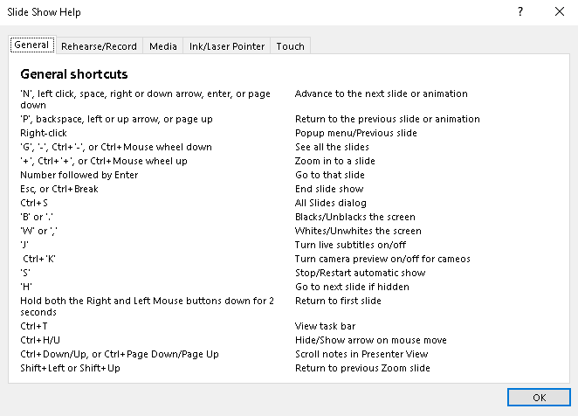
Slide Show Shortcuts
F1 brings up all shortcuts
Only works when presenting

Slide 20
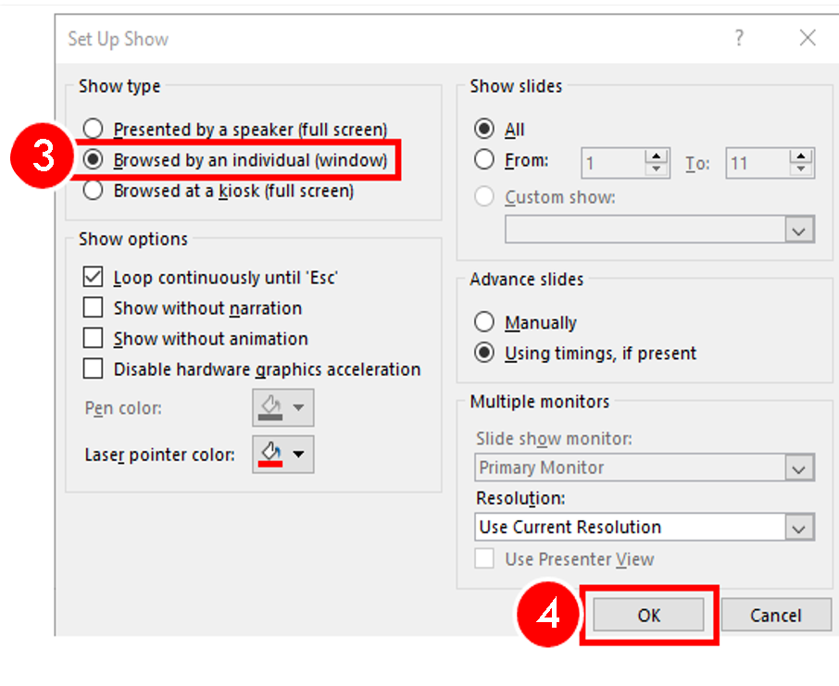
Slide Show in a window
Slides presented in a resizable window
Can put slide deck side by side with another window
Task, Title and Status Bar remain in view
Back and forward slide buttons show on the status bar
Can still switch to full screen; use esc to go back
Disables ‘presenter view’

Slide 21
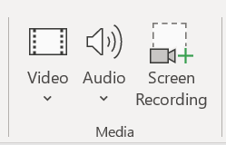
Screen Recording
Capture your actions on the computer screen and record them as a video
Useful when creating tutorials or presentations that require a demonstration
To Use
Select the slide where you want to insert the screen recording
Click the Insert tab
Select the Screen Recording option from the Media group
Configure the recording settings
Select the area of the screen to record
Toggle audio on or off
Click on the Record button to start recording
Pause or stop the recording at any time by using the controls that appear on the screen
Click Stop button to end the recording
The recording will be inserted into your slide as a video.
You can then save, edit and customize the video as you would with any other media in PowerPoint.

Slide 22
Embed Power BI
With the Power BI add-in, you can add live Power BI reports to your PowerPoint slides.
To Use
Get the URL of the Power BI report from the workspace
Go to Power BI workspace
Click share for the Power BI Report
Click Copy link
Insert > Power BI
Paste the URL into the Power BI add-in

Slide 23
Questions?

