Slide 1
Tips and Tricks
12/14/2023
Presented by: Bryan.Brownlow@Teksouth.com

Slide 2
Join or Relationship Keys
What is Primary Key?
A primary key is used to ensure that data in the specific column is unique. A column cannot have NULL values. It is either an existing table column or a column that is specifically generated by the database according to a defined sequence.
Should not have any duplicate or NULL values.
What is Foreign Key?
A foreign key is a column or group of columns in a table that provides a link between data in two tables. It is a column (or columns) that references another column (most often the primary key) of another table. Not unique.

Slide 3
Fact vs Lookup Table
A Fact Table (also known as a Data Table) is one that holds the keys of the referenced lookup tables along with some quantitative metrics (i.e. measurements) over which some sort of calculation can be performed. Some common examples of facts tables include orders, logs and time-series financial data.
Generally, have foreign (not unique) keys.
Lookup Tables (also known as a Dimension Tables) hold the descriptive information for related fields that are included in the fact table’s records. A few common examples of Dimension Tables are physical entities such as a Customer and Product tables or even Time Tables. In general, the Dimension Tables are expected to be much smaller in size compared to Fact Tables.
Generally, have primary (unique) keys.

Slide 4
One to One Relationship
1
1
This means that for every row in a table, there is exactly one matching record in another table.

Slide 5
One to One Relationship: Example
A table of people would connect to another table of Social Security Numbers by a 1 to 1 relationship.
First Name | Last Name | Occupation | Social Sec #
Peter | Pan | Lost Boy | 123-456-789
Captain | Hook | Pirate | 432-543-765
Mr | Smee | First Mate | 098-876-765
Social Sec # | Retirement Eligibility
123-456-789 | Never
432-543-765 | April 1
098-876-765 | Nov 15

Slide 6
One to Many Relationship
1
*
This means that for every row in a table, there are many matching records in another table.

Slide 7
One to Many Relationship: Example
A table of locations would connect to another table of residents by a one to many relationship.
Location | Zip Code
London | 98765
Neverland | 87654
The Jolly Roger | 65432
Pixie Hollow | 76567
First Name | Last Name | Zip Code
Peter | Pan | 87654
Captain | Hook | 65432
Mr | Smee | 65432
Wendy | Darling | 98765
John | Darling | 98765
Tinker | Bell | 76567
Michael | Darling | 98765

Slide 8
Many to Many Relationship
*
*
This means that a record exists many times in one table and many times in another table.

Slide 9
Many to Many Relationship: Example
Each class will have many students, and any students will take many classes.
Course Name | Course Code
Advanced Topics in Piracy | PI401
Introduction to Flight Mechanics | FM101
Intermediate Nautical Navigation | NN201
Introduction to Herpetology | BIO102
First Name | Last Name | Zip Code
Peter | Pan | 87654
Captain | Hook | 65432
Mr | Smee | 65432
Wendy | Darling | 98765
John | Darling | 98765
Tinker | Bell | 76567
Michael | Darling | 98765

Slide 10
Connect to Tables (Power Query)
Click inside the table to be connected to Power Query
Select the “Data” tab in Excel then select “From Table/Range” in the “Get and Transform Data” section.
3. This will connect the table and load the data into the Power Query Editor.

Slide 11
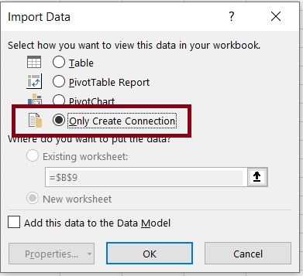
Connect to Tables (Power Query)
Hover over “Close and Load” then select “Close and Load To”
In the “Import Data” dialog box, select “Only Create Connection” then select “OK”

Slide 12
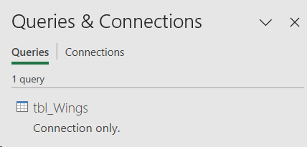
Connect to Tables (Power Query)
Connection will now be loaded into the “Queries and Connections” panel.
Repeat these steps for every table to be connected.

Slide 13
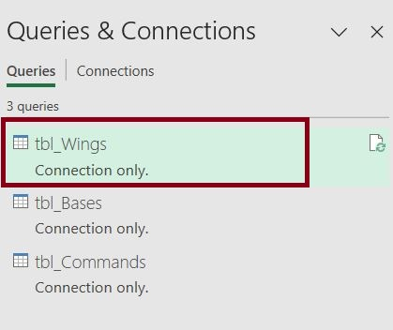
Check Number of Rows
Right-click on the Fact Table and select “Load To.”

Slide 14
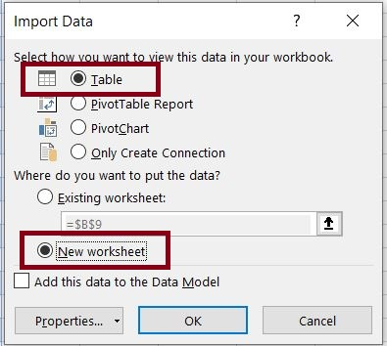
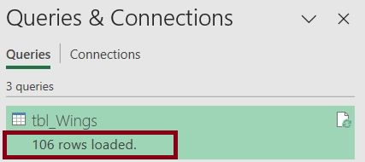
Check Number of Rows
Right-click on the Fact Table and select “Load To” then “OK.”
In the Import Data dialog box select “Table” and “New Worksheet” then click “OK.”
This will load the connected Fact Table into an Excel Worksheet.
Notice the number of Rows Loaded in Fact Table

Slide 15
Join Fact Table to Lookup Tables
Double click on the Fact Table in the Queries and Connections panel. This will load connection in the Power Query Editor.
On the Home tab in the Power Query Editor, select the “Merge Queries” dropdown in the Combine section then select “Merge Queries as New.”

Slide 16
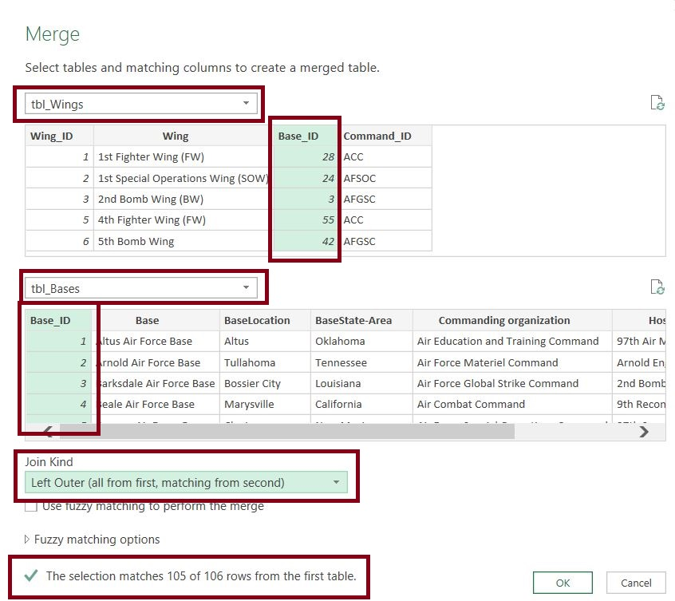
Join Fact Table to Lookup Tables
The Merge dialog box will be loaded. The first table should be your Fact Table. The second Table should be your lookup table. This is not required but a best practice.
Select the Fact Table column that will be the foreign key to join the tables.
Select the Lookup Table column that will be the primary key to join the tables.
Ensure the “Left Outer” join kind is selected. Again, this is not required but a best practice.
The Selection Matches show how many of your foreign keys have primary key matches.
Select “OK” on the Merge dialog box

Slide 17
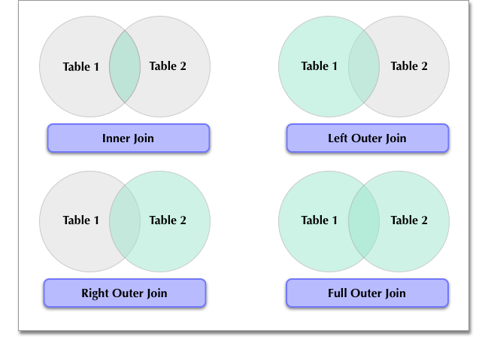
Join Types

Slide 18
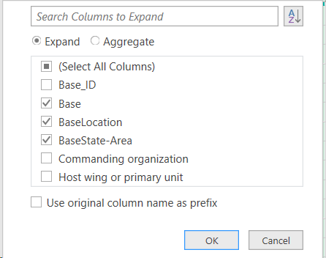
Join Fact Table to Lookup Tables
The Lookup Table will be added to the end of the Fact Table. Click the “Two Arrows” to expand the Lookup Table.
Select which columns from the Lookup Table you would like to add to the Fact Table and click “OK.”

Slide 19
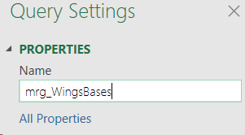
Join Fact Table to Lookup Tables
Rename the merge query.
Hover over “Close and Load” then select “Close and Load To.”
On the Import Data dialog Box select “Table” and “New Worksheet” then click “Ok.”

Slide 20
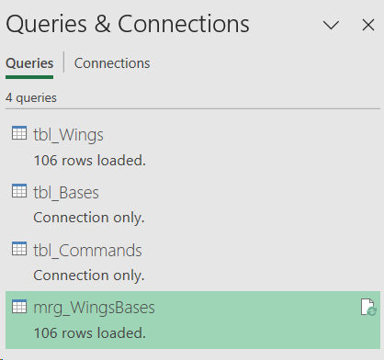
Join Fact Table to Lookup Tables
Note the number of rows loaded.
Merge other Lookup Tables into this query.
After each Lookup Table is joined, reload the query into the Excel worksheet note the number of rows loaded.
Note: If the number of rows loaded in the Fact Table is greater than the number of rows loaded in the new merge table, there are duplicate primary keys in the “Lookup Table.”

Slide 21
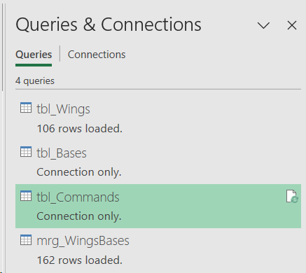
Test for Duplicates in Lookup Table
Double click on the Lookup Table in the Queries and Connections panel that has the duplicate primary keys.

Slide 22
Test for Duplicates in Lookup Table
Click on the Primary Key Column and ensure it is highlighted.
Select the Home tab then click “Group By” in the Transform Section.

Slide 23
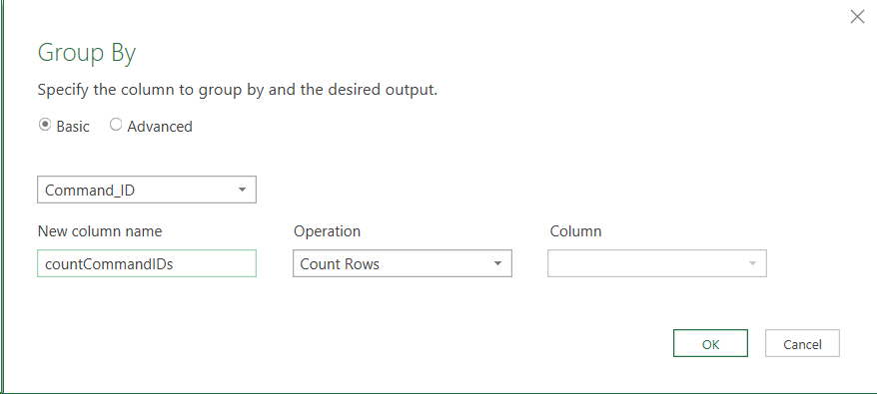
Test for Duplicates in Lookup Table
Ensure the Primary Key is selected in the first box.
Name the New Column.
Ensure the Operation is set to “Count Rows.”
Click “Ok.”

Slide 24
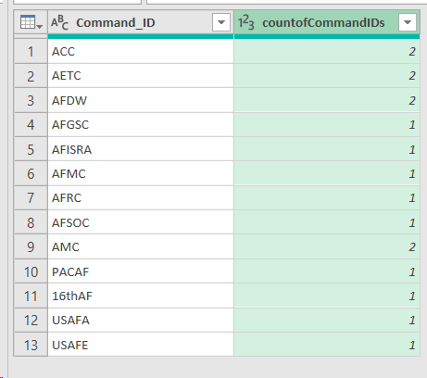
Test for Duplicates in Lookup Table
A list of the Primary Keys and the Count of times that are listed in the Lookup Table will be provided.
Reminder: Lookup Tables should have unique Primary Keys. If a Lookup Table has multiple Primary Keys, the Table needs to be scrubbed to ensure the Primary Keys are unique.

Slide 25
Appendix
The following slides are a reference from the previous Join Tips and Tricks session on 11/16/2023.

Slide 26
Vlookup Function
=VLOOKUP (lookup_value, table_array, col_index_num, [range_lookup])
Lookup_value: The value you want to look up.
Table_array: The range of cells in which the VLOOKUP will search for the lookup_value and the return value.
Col_index_num: The column number (starting with 1 for the left-most column of table_array) that contains the return value.
Range_lookup: A logical value that specifies whether you want VLOOKUP to find an approximate or an exact match: TRUE if numbers (1) = Approximate Match or FALSE if text (0) = Exact Match.
Notes:
The first column in the cell range must contain the lookup value.
Range lookup will almost always = 0 for Exact Match
If using Vlookup is being used to join tables, Table_array needs to be an absolute reference.
Vlookup Reference

Slide 27
Index function
=INDEX(array, row_num, [column_num])
array: A range of cells or an array constant.
row_num (Required, unless column_num is present): Selects the row in array from which to return a value. If row_num is omitted, column_num is required.
column_num (optional): Selects the column in array from which to return a value. If column_num is omitted, row_num is required.
Notes:
If array contains only one row or column, the corresponding row_num or column_num argument is optional.
If array has more than one row and more than one column, and only row_num or column_num is used, INDEX returns an array of the entire row or column in array.
Index Reference:

Slide 28
Match function
=MATCH(lookup_value, lookup_array, [match_type])
lookup_value: The value that you want to match in lookup_array.
lookup_array: The range of cells being searched.
match_type (optional): The number -1, 0, or 1. The match_type argument specifies how Excel matches lookup_value with values in lookup_array. The default value for this argument is 1.
1 or Omitted – MATCH finds the largest value that is less than or equal to lookup_value.
0 – MATCH finds the first value that is exactly equal to lookup_value.
-1 - MATCH finds the smallest value that is greater than or equal to lookup_value
Notes:
MATCH returns the position of the matched value within lookup_array, not the value itself.
MATCH does not distinguish between uppercase and lowercase letters when matching text values.
If MATCH is unsuccessful in finding a match, it returns the #N/A error value.
If match_type is 0 and lookup_value is a text string, you can use the wildcard match where *, ?, and ~ have special meaning.
Match Reference:

Slide 29
Index Match function
= INDEX(array,MATCH(lookup_value, lookup_array, [match_type]))_
Index:
array: A range of cells or an array constant.
row_num: Uses Match function.
Match (used to obtain row_num)”
lookup_value: The value that you want to match in lookup_array.
lookup_array: The range of cells being searched.
match_type (optional): The number -1, 0, or 1. The match_type argument specifies how Excel matches lookup_value with values in lookup_array. The default value for this argument is 1.
1 or Omitted – MATCH finds the largest value that is less than or equal to lookup_value.
0 – MATCH finds the first value that is exactly equal to lookup_value.
-1 - MATCH finds the smallest value that is greater than or equal to lookup_value

Slide 30
Xlookup Function – Only available in Excel 2021+
=XLOOKUP(lookup_value, lookup_array, return_array, [if_not_found], [match_mode], [search_mode])
lookup_value: The value to search for.
lookup_array: The array or range to search.
return_array: The array or range to return.
[if_not_found] (optional): Where a valid match is not found, return the [if_not_found] text you supply.
[match_mode] (optional): Specify the match type:
0 - Exact match. If none found, return #N/A. This is the default.
-1 - Exact match. If none found, return the next smaller item.
1 - Exact match. If none found, return the next larger item.
2 - A wildcard match where *, ?, and ~ have special meaning
[search_mode] (optional): Specify the search mode to use:
1 - Perform a search starting at the first item. This is the default.
-1 - Perform a reverse search starting at the last item.
2 - Perform a binary search that relies on lookup_array being sorted in ascending order. If not sorted, invalid results will be returned.
-2 - Perform a binary search that relies on lookup_array being sorted in descending order. If not sorted, invalid results will be returned.
Xlookup Reference:

